Slide 1
Travel agent
CAPSTONE PROJECT
Presented By:
Student name : Som Prasad
College Name : Heritage Institute of Technology, Kolkata
Department: IT

Slide 2
OUTLINE
Problem Statement
Technology used
Wow factor
End users
Result
Conclusion
Git-hub Link
Future scope
IBM Certifications

Slide 3
Problem Statement
Planning a trip is often a complex, fragmented, and time-consuming process for users. Individuals must navigate numerous websites and applications to find flights, accommodations, activities, and dining options that fit their budget and preferences. This information overload makes it difficult to build a cohesive and optimized itinerary. The crucial challenge is to simplify this process, transforming it from a stressful task into a seamless and enjoyable experience by providing personalized, real-time travel plans.
Proposed Solution : An AI Travel Planner Agent that uses Natural Language Processing (NLP) and a tool-using agentic framework. The agent will act as a personal travel expert, simplifying planning through a conversational interface. It will understand user needs, connect to live travel APIs, and automatically generate personalized, end-to-end itineraries.

Slide 4
Technology used
IBM cloud lite services
Natural Language Processing (NLP)
Retrieval Augmented Generation (RAG)
IBM Granite model

Slide 5
IBM cloud services used
IBM Cloud Watsonx AI Studio
IBM Cloud Watsonx AI runtime
IBM Cloud Agent Lab
IBM Granite foundation model

Slide 6
Wow factors
This agent transforms hours of stressful trip planning into a simple, two-minute conversation, acting as a 24/7 personal travel expert. It eliminates the need to browse dozens of websites by providing a single, intelligent interface for all travel needs.
Unique features:
Conversational Planning: Plan entire trips using simple, natural language.
Real-Time Data Integration: Get live prices and availability for flights and hotels by connecting to travel APIs.
Deep Personalization: Generates itineraries based on the user's specific budget, travel style (e.g., "relaxing," "adventurous"), and interests.
Dynamic Itinerary Generation: Creates complete, day-by-day plans with suggested activities and dining options.

Slide 7
End users
Casual Vacationers & Families: Individuals planning holiday trips.
Business Travelers: Professionals needing efficient and quick planning for work trips.
Backpackers and Solo Travelers: Adventurers looking for budget-friendly and unique travel experiences.
Travel Agencies: As a powerful tool to quickly generate baseline itineraries for clients.

Slide 8
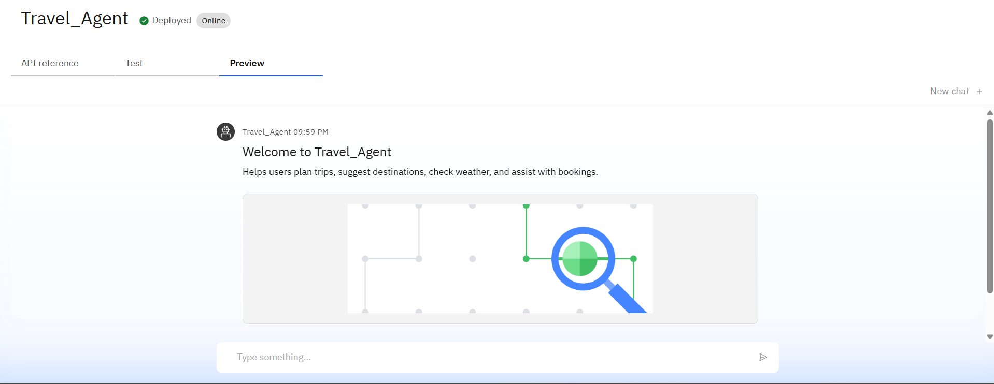
Results

Slide 9
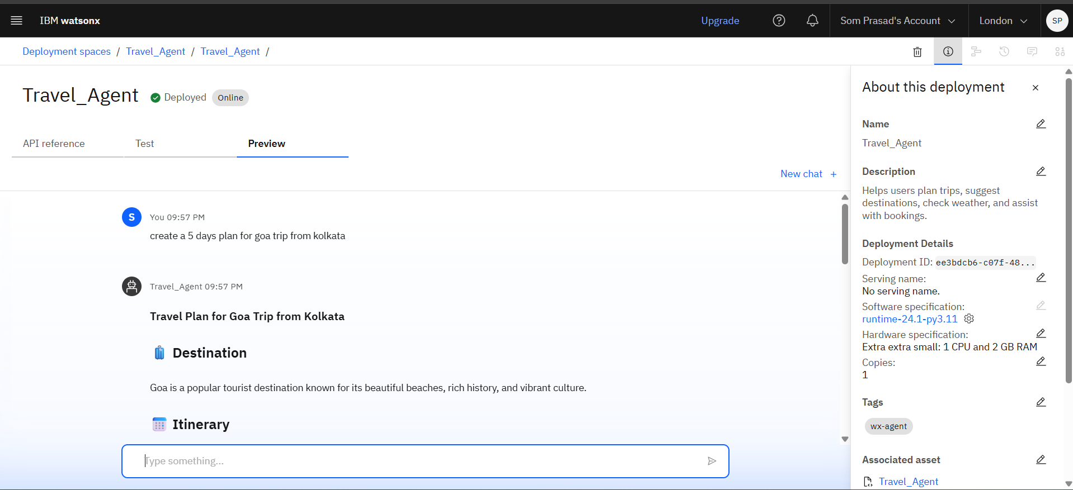
Results

Slide 10
Conclusion
The AI Travel Planner Agent successfully automates the fragmented process of planning a trip, saving users significant time and effort.
By integrating conversational AI with live data, the agent provides highly personalized and actionable itineraries.
The project demonstrates the power of LLM-powered agents to enhance efficiency and create innovative solutions for complex, real-world tasks.

Slide 11
Future scope
Direct Booking Integration: Allow users to book flights and hotels directly through the agent's interface.
Proactive In-Trip Assistance: Send real-time alerts for flight delays, gate changes, or significant weather events.
Visual Itineraries: Generate a map-based view of the travel plan.
Multilingual Support: Enable the agent to assist users in multiple languages.
Voice-Activated Assistant: Create a voice-enabled version of the agent for hands-free planning.

Slide 12
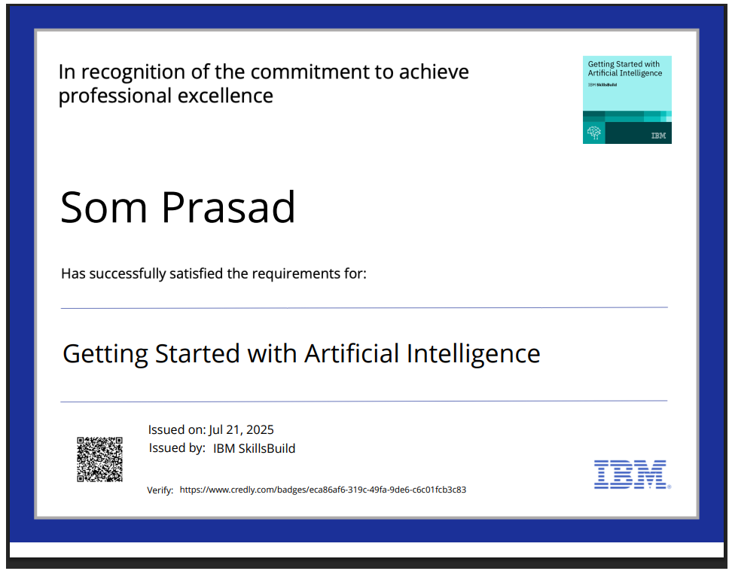
IBM Certifications

Slide 13
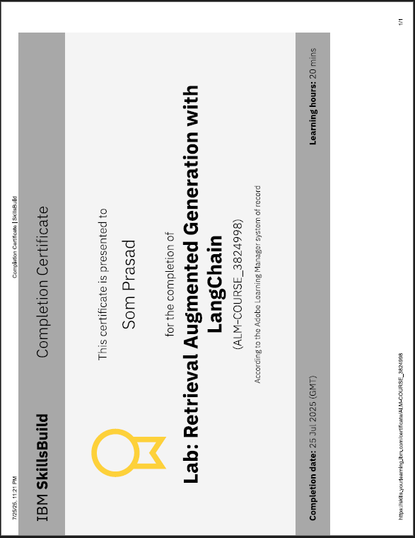

Slide 14
GitHub Link
Link : https://github.com/som204/Travel-Agent.git

Slide 15
THANK YOU

